Slide 1
Dictionary of Protein Secondary Structure Pattern Recognition of Hydrogen-Bonded and Geometrical Features
Wolfgang Kabsch and Christian Sander
Biopolymers,Vol. 22, pp2577-2637, 1983
Created by:Chia-Chang Wang
Date:Sept. 3,2004

Slide 2
Abstract
For a successful analysis of the relation between amino acid sequence and protein structure, an unambiguous and physically meaningful definition of secondary structure is essential. We have developed a set of simple and physically motivated criteria for secondary structure, programmed as a pattern-recognition process of hydrogen-bonded and geometrical features extracted from x-ray coordinates. Cooperative secondary structure is recognized as repeats of the elementary hydrogen-bonding patterns “turn” and “bridge”.

Slide 3
Abstract(Cont.)
Repeating turns are “helices”, repeating bridges are “ladders”, connected ladders are “sheets”. Geometric structure is defined in terms of the torsional handedness of four consecutive positions and is defined as “bends”. Solvent “exposure” is given as the number of water molecules in possible contact with a residue. The end result is a compilation of the primary structure, including SS bonds, secondary structure, and solvent exposure of 62 different globular proteins.

Slide 4
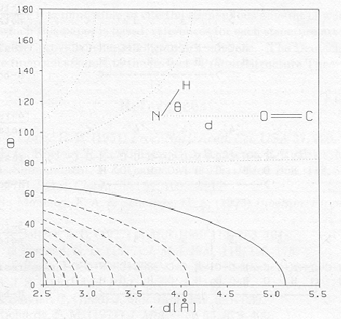
The definition of H-bond
Hbond(i,j)=[E<-0.5kcal/mole]
63
E=-3.0 kcal/mol
5.2

Slide 5
Hydrogen Bonds
We calculate the electrostatic interaction energy between two H-bonding groups by placing partial charges on the C,O(+q1,-q1) and N,H(-q2,+q2)atoms.
q1=0.42e,q2=0.20e
r(AB): the interatomic distance from A to B
f:the dimensional factor(=332)

Slide 6
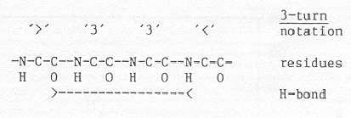
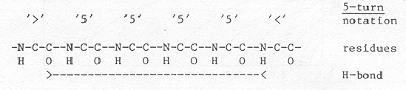
Elementary H-bond Pattern: n-Turn
n-turn(i) = Hbond(i,i+n),n=3,4,5
i
i+3
i
i+5

Slide 7
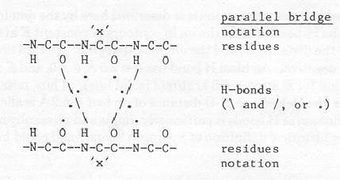
Elementary H-bond Pattern: Bridge
Parallel Bridge(i,j)=
[Hbond(i-1,j) and Hbond(j,i+1)] or
[Hbond(j-1,i) and Hbond(i,j+1)]
i-1
i
i+1
j-1
j
j+1

Slide 8
Cooperation H-Bond Pattern:Helices
A minimal helix is defined by two consecutive n-turn.
ex:
4-helix(i,i+3)=[4-turn(i-1) and 4-turn(i)]
i.e an h bond(i-1,i+3) and an H bond(i,i+4)
Longer helices are defined as overlaps of minimal helices.

Slide 9

Cooperation H-Bond Pattern:Beta-Ladders and Beta-Sheets
Ladder
set of one or more consecutive bridges of identical type
Sheet
set of one or more ladders connected by shared residues

Slide 10
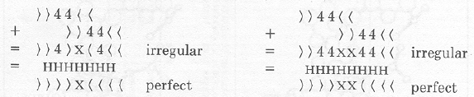
Secondary Structure Irregularities
Long helices can deviate from regularity in that not all possible H bonds are formed.
Notes:
Due to kink in the helix

Slide 11

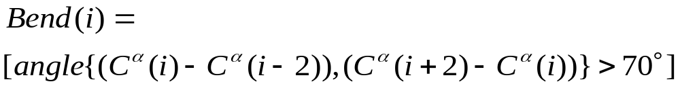
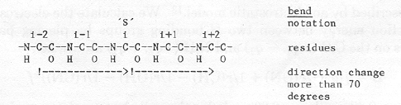
Geometrical Structure - Bend
With the position vector of ,we define

Slide 12
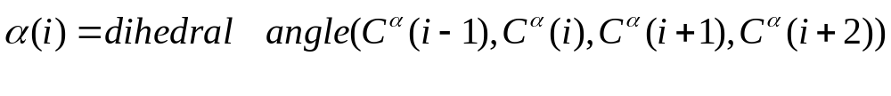
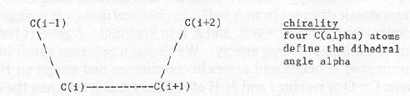

Geometrical Structure - Chirality
We define chirality at each residue as
Notes:
生物世界是一個不對稱的世界，如果你注意觀察過你的手，你會發現左右手在空間上無法完全重合，但左手和右手的鏡像卻能重合。在化學中這種現象被稱之為「手性(chirality)」，幾乎所有的生物大分子都是手性的。比如，組成人體的糖類一般是右旋的，而構成蛋白質的氨基酸都是左旋的。而左旋的糖和右旋的氨基酸，幾乎不能被人體利用。一般認為，在非手性的環境中不能産生手性化合物，而只能産生外消旋體，即等量的右旋和左旋體構成的混合物。

Slide 13
Choice of Protein
From PDB(75 complete backbone coordinates and a known amino acid sequence)
When two protein data sets had more than 50% sequence homology,the one with higher resolution was been chosen.
(62 data set are chosen finally)

Slide 14
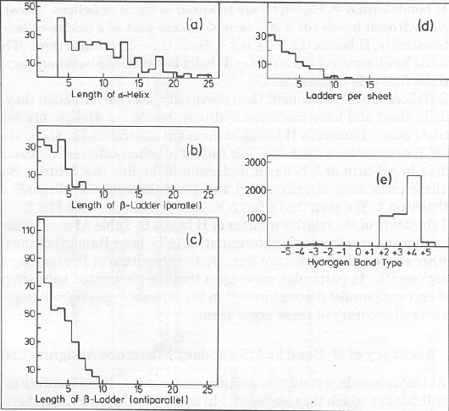
Turns and Helices

Slide 15
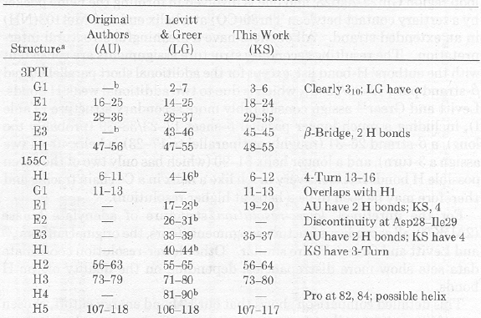
Accuracy of H-Bonds and Secondary Structure Assignments

Slide 16

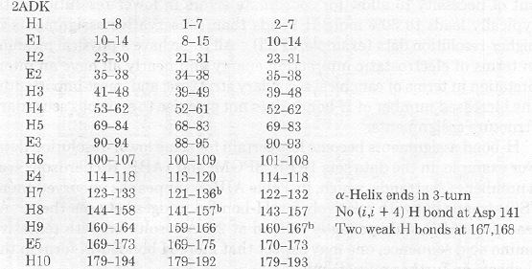
Accuracy of H-Bonds and Secondary Structure Assignments

